Slide 1

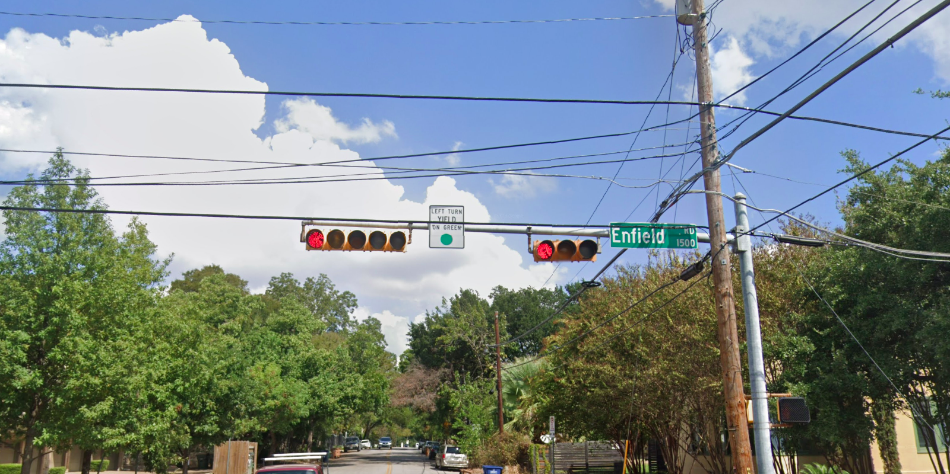
Austin Transportation Department Signs Work Orders
Created By: Susanne Gov Created Date: 2020-05-21 Location Name: ENFIELD RD / WEST LYNN ST Intersection ID: 5154815 Cardinal Direction: N
Sign Type | Install/Remove
Left Turn Yield On Green | Install
Street Name Sign | Install

Slide 2
Austin Transportation Department Signs Work Orders
Created By: Susanne Gov Created Date: 2020-05-21 Location Name: ENFIELD RD / WEST LYNN ST Intersection ID: 5154815 Cardinal Direction: S
Sign Type | Install/Remove
Left Turn Yield On Green | Install
Street Name Sign | Install

Slide 3
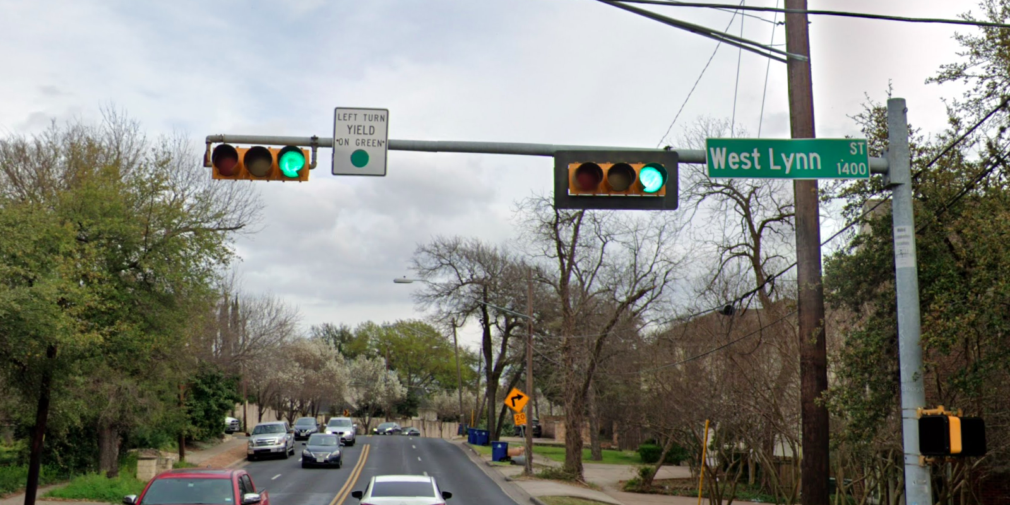
Austin Transportation Department Signs Work Orders
Created By: Susanne Gov Created Date: 2020-05-21 Location Name: ENFIELD RD / WEST LYNN ST Intersection ID: 5154815 Cardinal Direction: E
Sign Type | Install/Remove
Left Turn Yield On Green | Install
Street Name Sign | Install

Slide 4
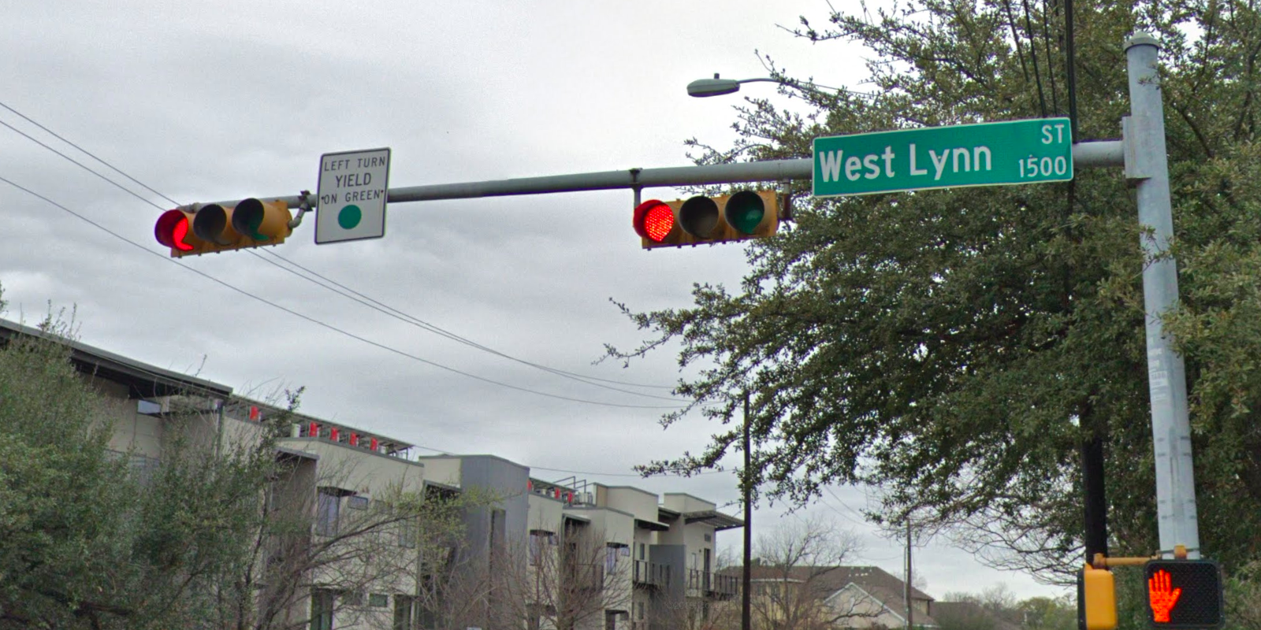
Austin Transportation Department Signs Work Orders
Created By: Susanne Gov Created Date: 2020-05-21 Location Name: ENFIELD RD / WEST LYNN ST Intersection ID: 5154815 Cardinal Direction: W
Sign Type | Install/Remove
Left Turn Yield On Green | Install
Street Name Sign | Install

